Slide 1
Material Foundation
2018 / 05 / Mario

Slide 2
ABOUT ADOBE XD

Slide 3
AODBE XD CAN….
PROTOTYPING
EXPORT UI ASSETS FOR DEVELPOERS

Slide 4
AODBE XD CAN….
PROTOTYPING
EXPORT UI ASSETS FOR DEVELPOERS

Slide 5

幫我弄一張
的頭像圖檔
240 dp

Slide 6


Slide 7


Slide 8


Slide 9


Slide 10
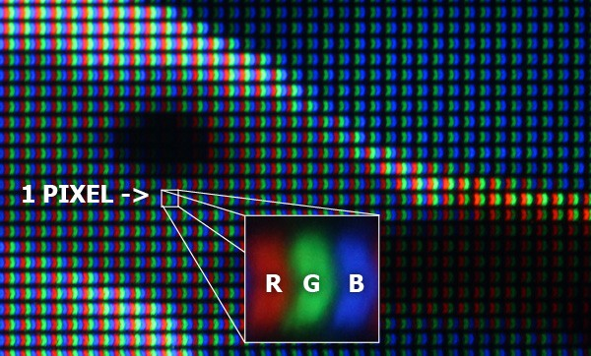
physical pixels
Your screen is shining a million tiny colored lights at your eyes. These lights are sometimes referred to as physical pixels. “Pixel” is an abbreviation for “picture element” and “physical” refers to the fact that the “element”, in this case, is an actual light (technically three lights) behind the glass on your device.

Slide 11
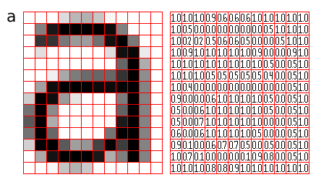
the logical pixel
There’s another kind of pixel, the logical pixel. When we are describing images by citing their pixel dimensions in Photoshop, and other design tools, we’re talking about logical pixels. The “logical” refers to the fact that these pixels are just information: they specify a color value at some location on a grid of tiny colored squares representing the image.

Slide 12
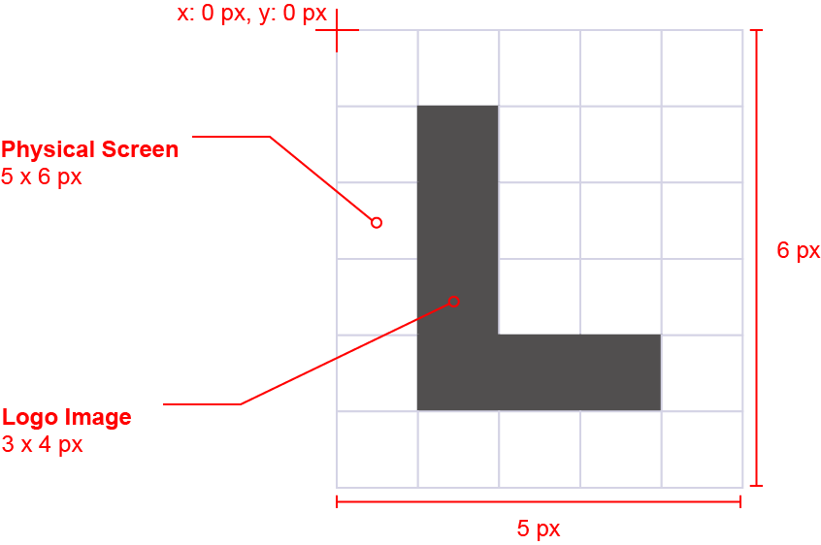
To illustrate
let’s pretend there is just one kind of pixel that describes both the dimensions of images and screens. Let’s introduce a super simple 3 x 4 pixel logo that is going to be displayed on a primitive 5 x 6 pixel screen.

Slide 13
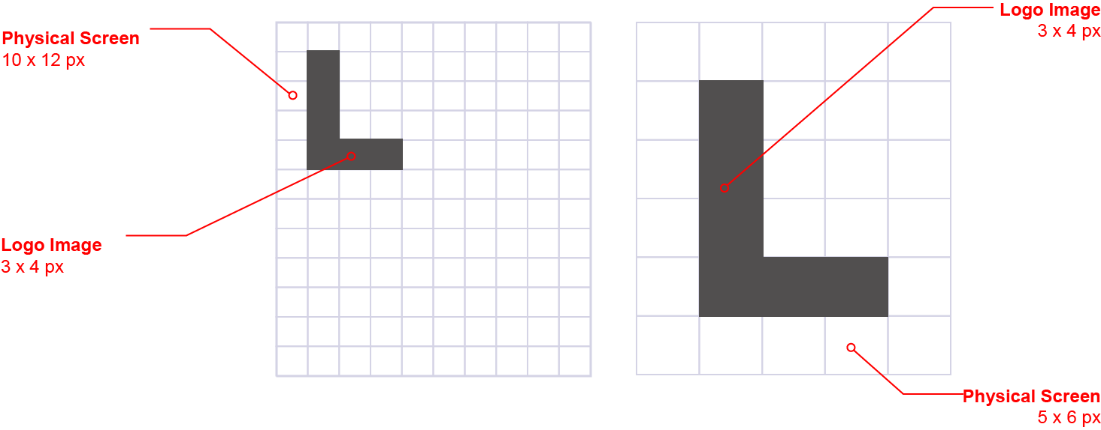
Now imagine
a new 10 x 12 screen has come out and we want our image to be displayed on that screen as well. Our 3 x 4 pixel logo would look tiny because of the higher resolution screen.

Slide 14
So and why
This situation is why the concept of logical pixels, independent of any physical medium or device, is required. This way we can encode an image by specifying logical pixel positions and colors, and the individual devices can specify how that information is mapped to each of the device’s physical pixels.

Slide 15
To accomplish
this mapping the device manufacturer specifies a device pixel ratio (dpr). This is just the amount of physical pixels necessary to display a single logical pixel along the height or width dimension.

Slide 16
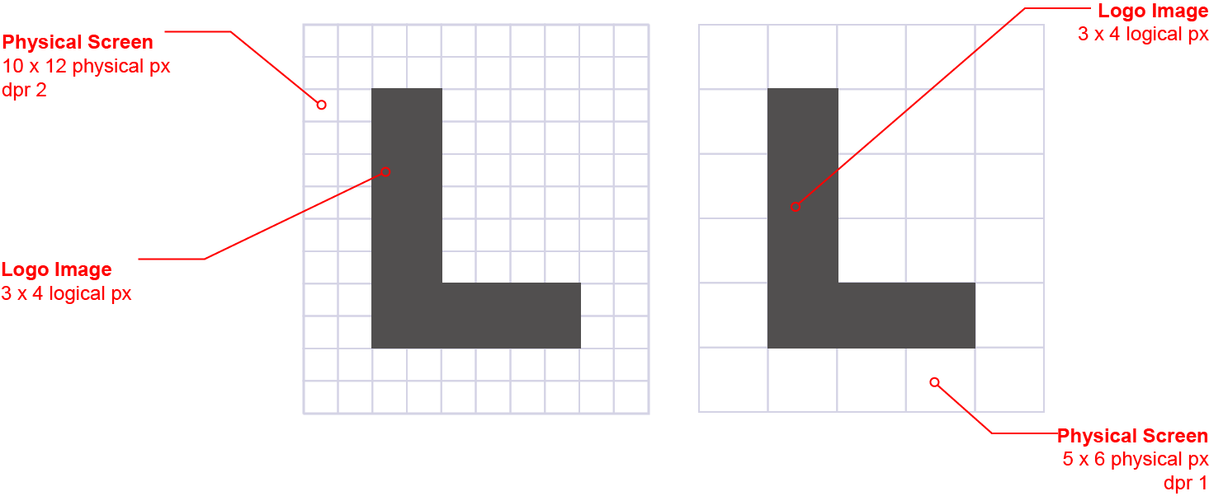
Using our example,
if the high-res screen manufacturer wanted to keep the displayed logo size consistent with the previous low-res screen, its device would have a dpr of 2, so that the logo’s 3 x 4 logical pixel dimensions would map to 6 x 8 physical pixels on the high-res device. On the low-res device the dpr is just 1 so 3 x 4 logical pixels map to 3 x 4 physical pixels.

Slide 17
The advantage
of this, is that device manufacturer’s can scale the resolutions of their devices while still being able to display content, designed for lower resolutions, at the same size on the new screens.

Slide 18
Speaking of pixels…
When designing for Android logical pixels are often referred to as device-independent pixels. Many of our users have been asking us to provide the option of using “dp” instead of “px” when designing for this platform.

Slide 19
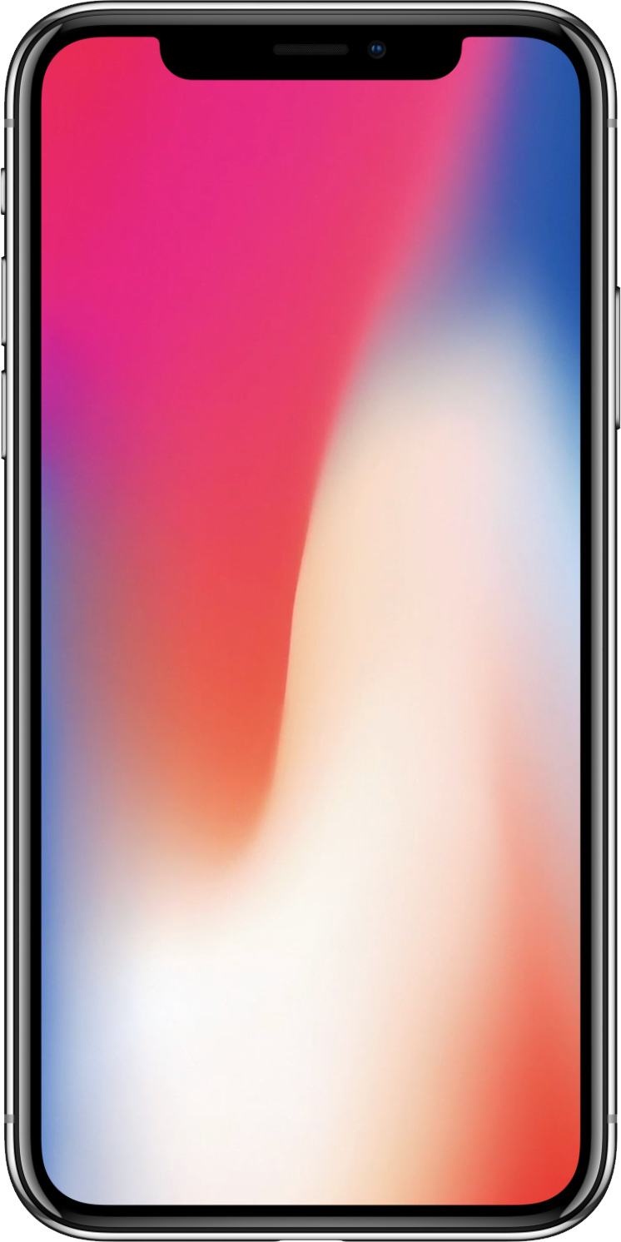
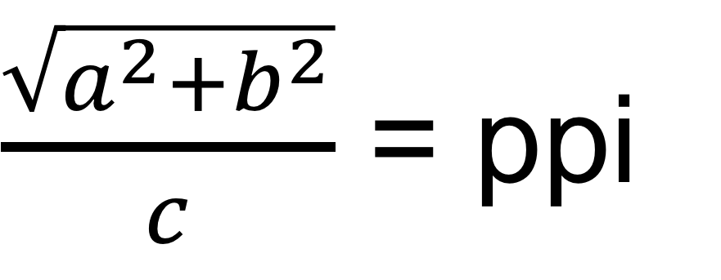
pixel per inch
$\frac{\sqrt{a^{2}+b^{2}}}{c}$ = ppi

Slide 20
Pixel density
The number of pixels that fit into an inch is referred to as pixel density. High-density screens have more pixels per inch than low-density ones. As a result, UI elements of the same pixel dimensions appear larger on low-density screens, and smaller on high-density screens. To calculate screen density, you can use this equation:
Screen density = Screen width (or height) in pixels / Screen width (or height) in inches

Slide 21
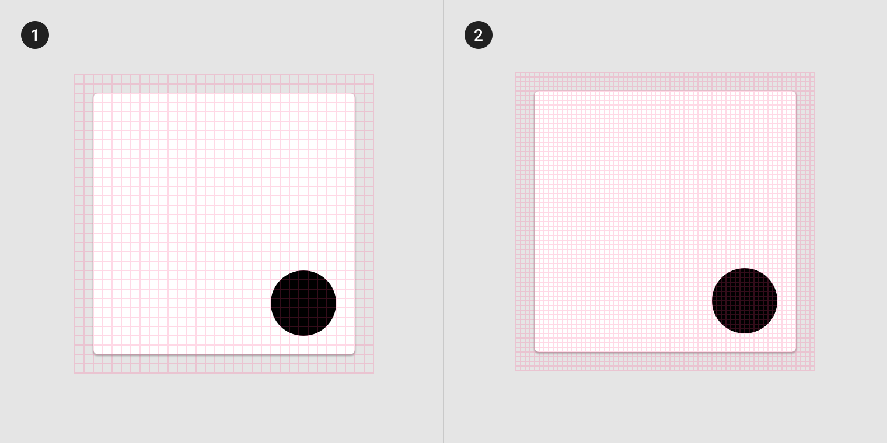
Density independence
Density independence refers to the uniform display of UI elements on screens with different densities.
Density-independent pixels, written as dp (pronounced “dips”), are flexible units that scale to have uniform dimensions on any screen. Material UIs use density-independent pixels to display elements consistently on screens with different densities.

Slide 22
Pixel density on Android
When developing an Android app, use dp to display elements uniformly on screens with different densities. A dp is equal to one physical pixel on a screen with a density of 160.
To calculate dp:
dp = (width in pixels * 160) / screen density
Screen physical width | Screen density | Screen width in pixels | Screen width in dps
1.5 in | 120 | 180 px | 240 dp
1.5 in | 160 | 240 px
1.5 in | 240 | 360 px

Slide 23
幫我弄一張
的頭像圖檔
240 dp

Slide 24
把你的答案寫在這

Slide 25
resourses
https://medium.com/uxabc/understanding-ui-units-8acdc0575388
http://ppi.0123456789.tw
http://iosres.com
https://material.io/tools/devices/
https://blog.specctr.com/pixels-physical-vs-logical-c84710199d62

Slide 26
簡易設計流程
設計
查裝置密度
依照密度縮放輸出

Slide 27
Responsive layout grid

Slide 28
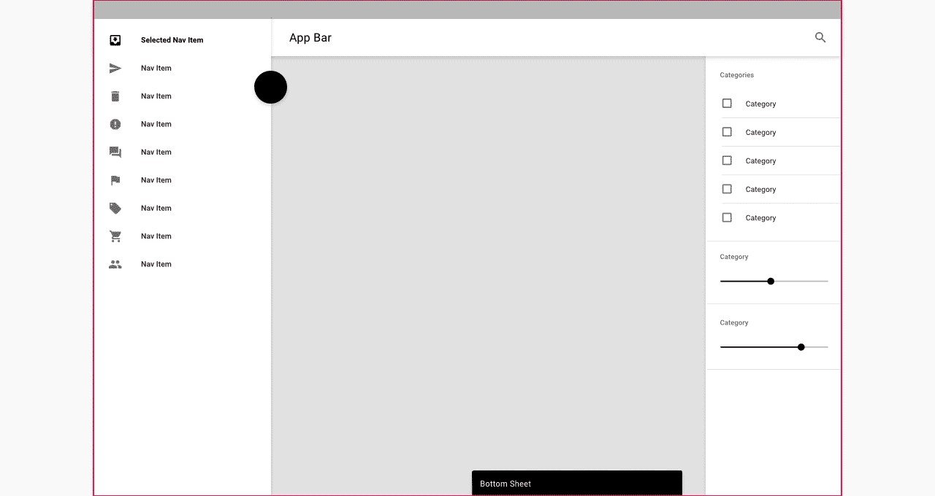
UI regions

Slide 29
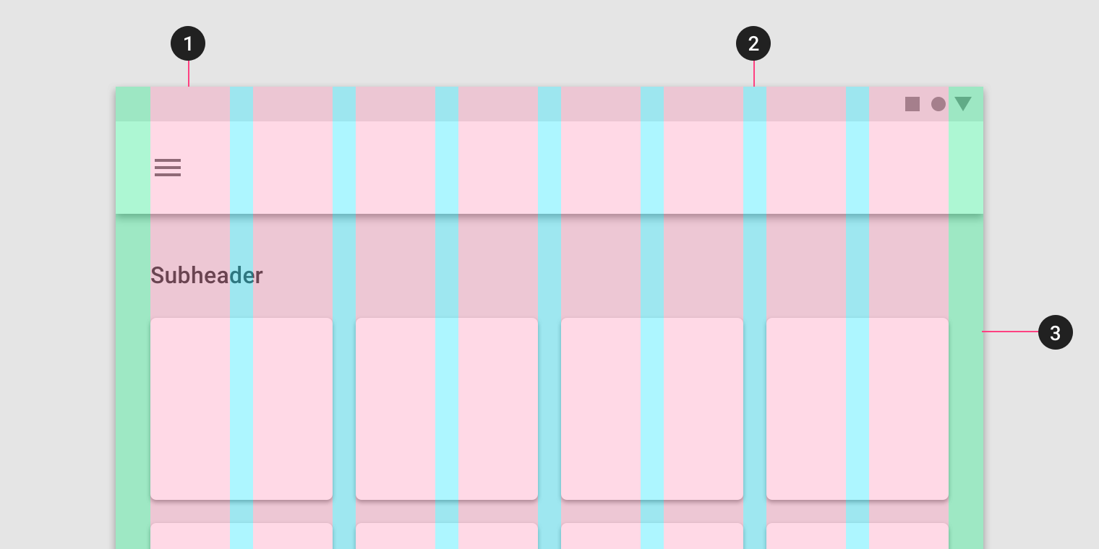
Columns, gutters, and margins

